Slide 1
类型检查

Slide 2
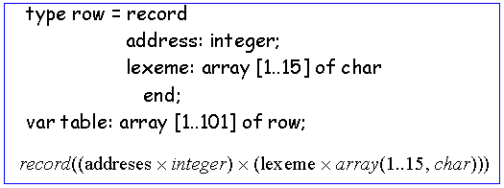
类型表达式
类型表达式可以是基本的数据类型也可以带有结构。
基本的数据类型 (boolean, char, integer and real) 是类型表达式
类型名字也是类型表达式
记录或结构与数组的类型表达式 E.g.:

Slide 3

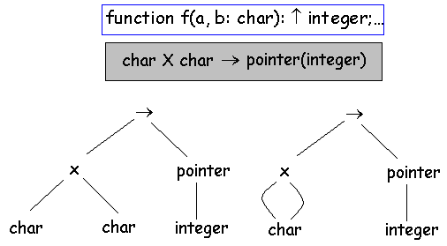
函数与指针的类型表达式:
Some languages allows functions to return an object of arbitrary type, e.g. LISP: (integer → integer) → (integer → integer)
类型图 (tree or DAG)

Slide 4

静态与动态的数据类型检查
A type system is a collection of rules for assigning type expression to the various parts of a program.
The type system is implemented by a type checker. The implementation can be easy made using syntax-directed manner from chap. 5.
Checked done by a compiler is static meanwhile the checking during the period of run of the program is said to be dynamically.
If the target code carry the type of element along with the value of this element, practically any check can be done dynamically
A sound system type eliminates the needs for dynamic checking (the free errors statically maintain also dynamically).
In practice, sometime some checks can be made only dynamically:

Slide 5
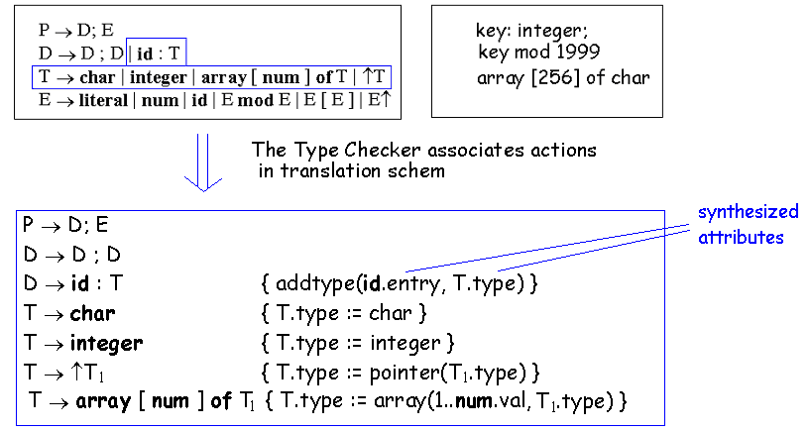
类型检查
The type checker is a translation scheme that synthesize the type of each expression from the types of its sub-expressions
E.g. grammar (each identifier must be declared before to be used):
The grammar can be modified in order to implement a suitable scheme for top-down or bottom-up parsing

Slide 6

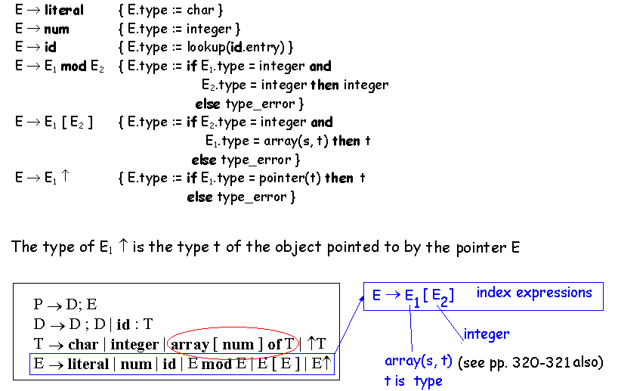
类型检查：表达式

Slide 7
类型检查: 语句
Because language constructs like statements doesn’t have values, a special basic type void can be assigned to them
If an error is detected in a statement, the type assigned to the statement is type_error
Statements considered in what follows: assignment, conditional and while.
For a program P → D; S that consist from declaration followed by statements checking expression are necessary because statements can have expressions within them

Slide 8
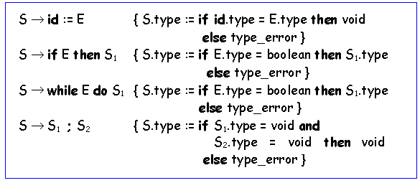

Slide 9

类型检查: 函数
The application of a function to an argument (f:D→R, f(x) = y) is captured by the production E → E ( E ) in which one expression is the application to another.
The rules for associating type expression with nonterminal T can be augmented by:
T → T₁ ′→′ T₂ { T.type := T₁.type → T₂.type }
The rule for checking the type of a function application is:
N arguments of type T₁, …T_{n}, can be viewed as a single argument of type T₁ × …×T_{n} . E.g.

Slide 10
类型表达式等价
The general form of rules used until now is “if two expressions are equal, then return a certain type, else return type_error”
We need a more explicit definition when two type expressions are equivalent.
Structural equivalence: two expression are either the same basic type, or are formed by the same constructor to structurally equivalent types.
In a DAG (algorithm 5.1, pp. 292) the identical type expression will be represented by the same node.

Slide 11
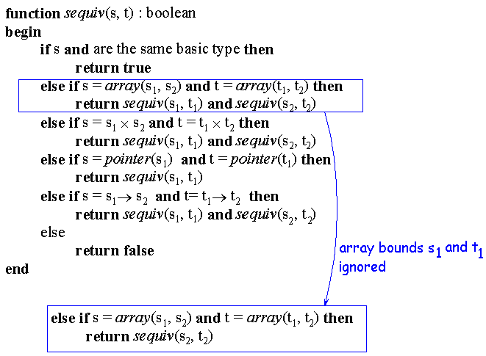
Algorithm for testing structural equivalence (type of constructor: arrays, products, pointers and functions):
Type graph notation can be sometime expansive; we can use some code for representation like a sequence of bits

Slide 12
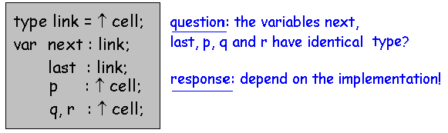
Potential ambiguities appears when we give name to type expressions and the names are used in subsequent expression.
We must verify if the name for expression stand for itself or it is an abbreviation for another expression.
In some languages types can be given names. E.g:
The Pascal language doesn’t define the term “identical type”
When names are allowed in type expressions, two notions of equivalence of type expression arise:
      name equivalence (each name is viewed as distinct type)
      structural equivalence (names are replaced by the expression that they define – substitutions)

Slide 13
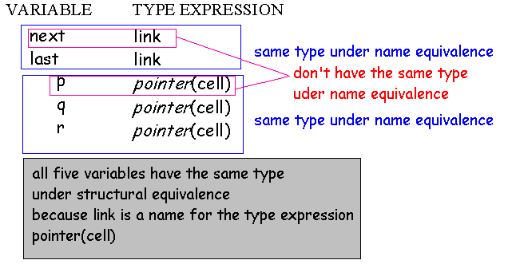
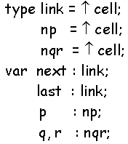
Some implementation creates a fresh name every time when a type expression appears in a variable declaration.The declaration is treated as:

Slide 14
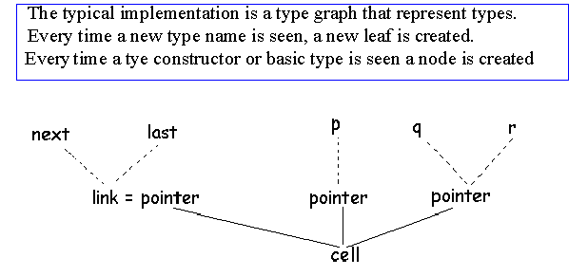
With this representation, two type expressions are equivalent if they are represented by the same node in the type graph.

Slide 15
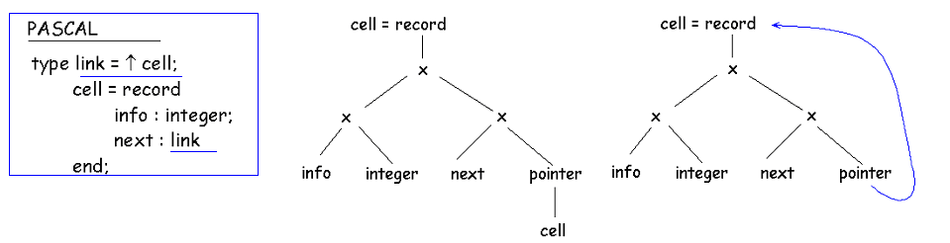
类型表达式: 环
Some data structures are defined recursively (e.g. linked list, trees)
Usually, these data structures contains records that have pointers or references to similar records: type names play a essential role in these cases
E.g. link is defined in terms of cell and cell is defined in terms of link
Recursively defined type names can be substituted if we want to introduce cycles in the graph

Slide 16
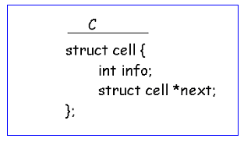
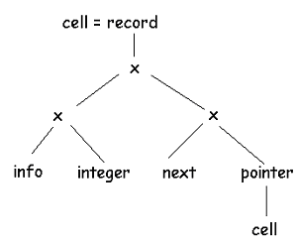
C language avoids cycles in type graphs using structural equivalence for all types except records
C uses the keyword struct instead of record and the name cell is part of the type of the record.

Slide 17
类型转换
In some expression (arithmetic expressions) some conversion are necessary: e.g. x + i, where x is real and i is integer.
Built-in function make the corresponding conversion when it is necessary (inttoreal, e.g.)
Conversion from one type to another is said to be implicit if it is done automatically by the compiler (coercions).
Conversion is said to be explicit if it is written by programmer (cast constructions, e.g.)
Coercion conversion is usually done when no loss of information is possible (e.g. integer to real).
But in conversion of real to integer it is possible loss of information: conversion are made only explicit

Slide 18
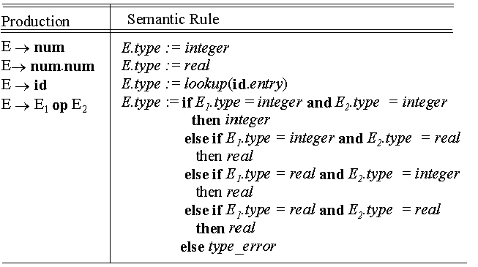

Slide 19
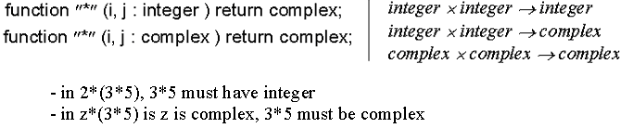
Overloading of functions and operators
An overloaded symbol is a symbol that has different meanings depending on its context
Overloading is solved when a unique meaning for an occurrence of an overloaded symbol is determined
E.g.
The simple case for arithmetic operator can be solved looking at type of involved operands, e.g.:
E → E₁ op E₂

Slide 20
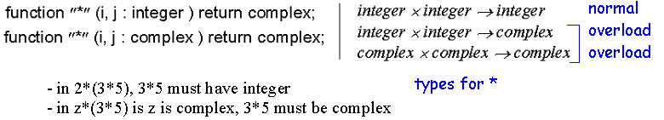
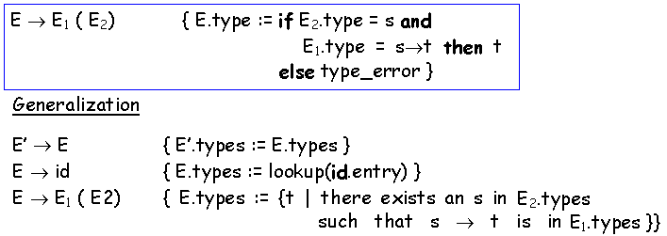
It is not always possible to resolve overloading by operator identification (e.g. looking at the arguments of a function)
E.g.:
The expression is assumed to have unique type (pp. 362). Type checking rule for function application was:

Slide 21
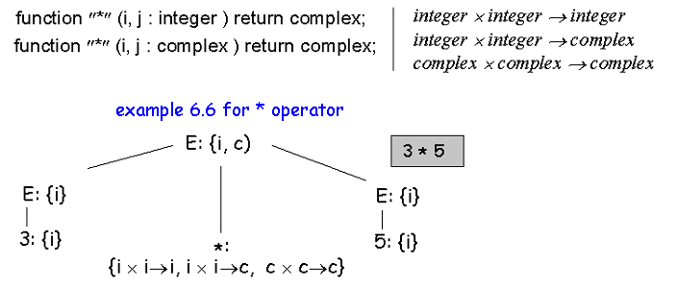
Example of set of possible types for expression 3 * 5

Slide 22
Polymorphic functions
Each time a polymorphic procedure is called, the statements of this body can be executed with arguments of different types
Built-in operators for indexing arrays, applying functions and manipulating pointers are usually polymorphic because they are not restricted to a particular kind of array, function or pointer.
In order to deal with polymorphic functions, the set of type expressions is extended to include expressions with type variables
some algorithmic issues rise about equivalence of type expressions
An important application of type variables is in languages that don’t require that the identifier to be declared before usage

Slide 23
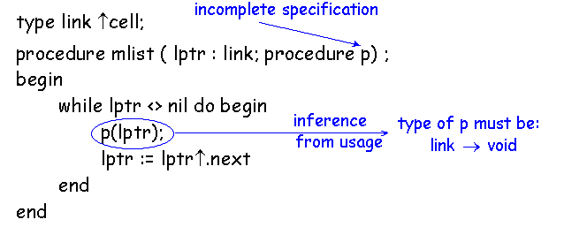
Type inference system is the problem of determining the type of language construct from the form that the construct has been used.
Type variables will be denoted by Greek letters: α, β, …
A variable represent the type of an undeclared identifier
Type-inference techniques can be applied to programs to fill the missing information at compile time (C, Pascal, etc.).
Example 6.8.

Slide 24
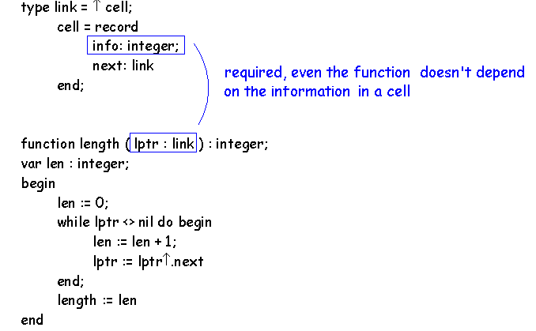

E.g.
In ML (a language with polymorphic functions):

Slide 25
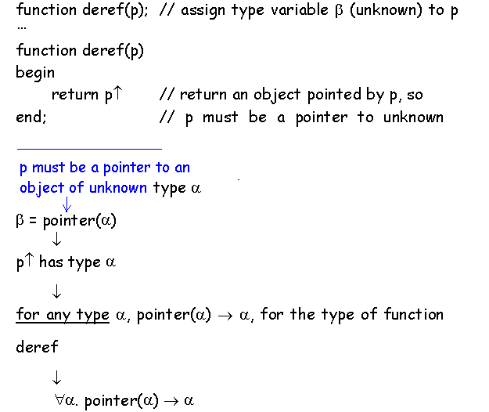
E.g. 6.9.

Slide 26
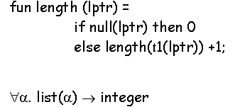
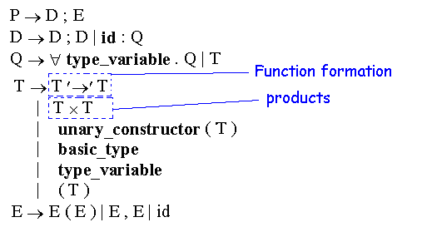
E.g. in ML language, for the length of a list (null ant t1-return the remainder of the list, are predefined functions) :
A type expression with ∀ symbol in it will be referred as a “polymorphic type” - ∀ universal quantifier: ∀α . pointer(α) → α
A grammar for checking polymorphic type:

Slide 27
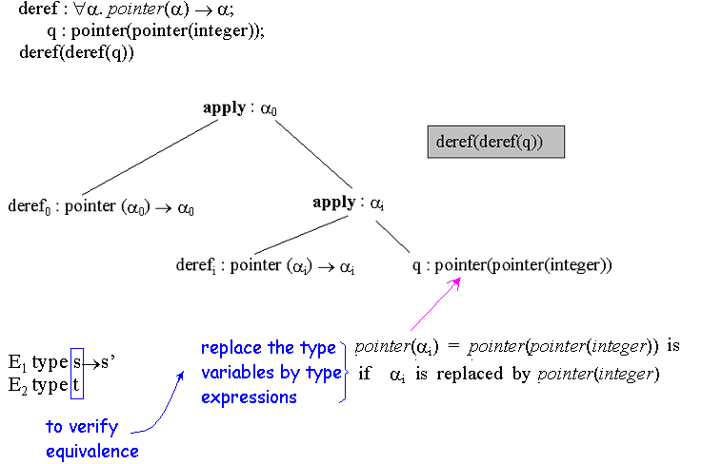
The programs consists of a sequence of declarations followed by a expression E to be checked:

Slide 28
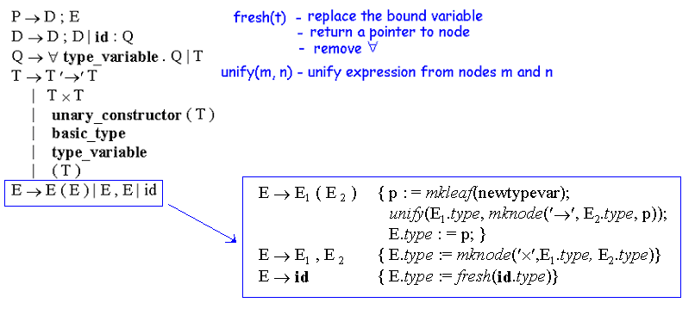
Checking polymorphic functions
The rules for checking expressions will be written using a graph representation of types (two functions: fresh(t) and unify(m, n))
When an identifier is declared, the type in the declaration is saved in the symbol table in the form of a pointer to the node representing the type (the synthesized attribute id.type)

Slide 29
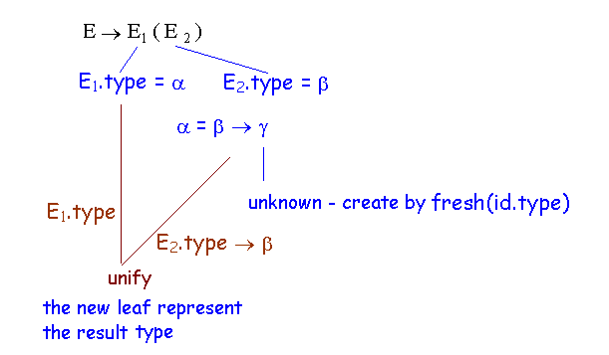
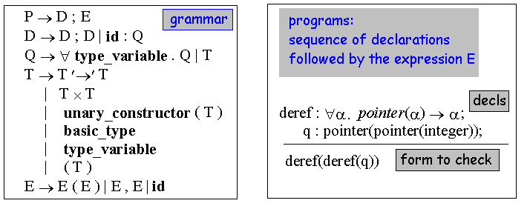

Slide 30
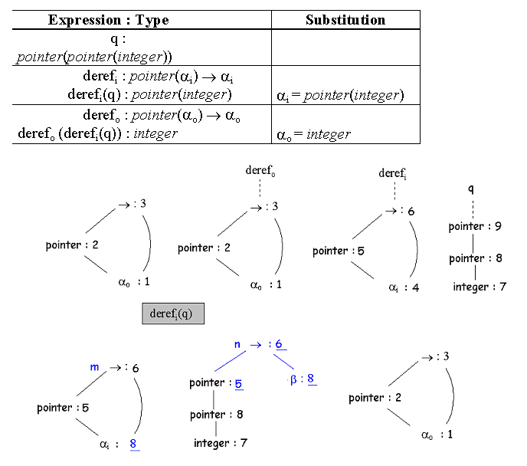
Nonterminal T generate expressions directly We started bottom up for declaration: deref_{o}(deref_{i}(q))

